Slide 1


Marcin Wnykowicz
16.07.2025

Slide 2

Outline
Executive Summary
Introduction
Methodology
Results
Conclusion
Appendix

Slide 3
Executive Summary
Methodologies used
Data collection via API and Web Scraping
Data wrangling
Exploratory Data Analysis (EDA)
Using SQL
Visualizations with Pandas and Matplotlib
Interactive Visualizations:
Interactive maps with Folium
Dashboard with Plotly Dash
Predictive analysis with ML
Classification Trees
Logistic Regression
SVM
Results
Model Performance
Best achieved with Decision Tree
New Insights
Factors influencing Falcon 9 first stage landings revealed
Launch site and payload mass have impact on landing success
Success rates calculated

Slide 4
Introduction
Background
SpaceX has revolutionized the commercial space industry by significantly reducing the cost of space travel. While traditional rocket launches can exceed $165 million, SpaceX advertises Falcon 9 launches for just $62 million – largely thanks to its ability to reuse the rocket’s first stage. In this capstone project, we aim to predict whether the first stage will successfully land. This gives an estimate, whether the first stage of the rocket can be reused and what will be the launch cost.
Problems to be solved
Analyze how payload mass, launch site, number of previous flights, and orbit type influence the success of Falcon 9 first stage landings.
Examine trends in landing success rates over time to determine whether performance has improved.
Identify and train the most effective machine learning algorithm to predict the first stage reuse.

Slide 5

Section 1

Slide 6
Methodology
Executive Summary
Data collection methodology:
SpaceX Rest API
Web Scrapping (Wikipedia)
Perform data wrangling
Standardizing
Halding missing values
One Hot Encoding
Perform exploratory data analysis (EDA) using visualization and SQL
Perform interactive visual analytics using Folium and Plotly Dash
Perform predictive analysis using classification models
Building, tuning and evaluation of different classification models and performing hyperparameter tuning

Slide 7
Data Collection
The data was collected by using the following:
API calls to request data directly from SpaceX REST API
Web Scraping to use data from SpaceX’s Wikipedia page
Usage of both source is crucial and gives a holistic view on SpaceX’s situation
SpaceX
REST API
Wikipedia
Web Scraping

Slide 8
Data Collection – SpaceX API
Key Points
Usage of Python’s requests library with a get function
Endpoint used for the data: https://api.spacexdata.com/v4/
Helper API functions used:
getBoosterVersion()
getLaunchSite()
getPayloadData()
getCoreData()
Replacing missing PayloadMass with it’s mean.
Requesting Rocket Launch Data from SpaceX API
Decoding the response and turning into dataframe
Using API again to request info for provided IDs
Merge all data into one dataframe
Filtering data, replacing missing values, exporting to csv
GitHub URL: https://github.com/mwnykowicz/Applied_Data_Science_Capstone_Project/blob/main/01-jupyter-labs-spacex-data-collection-api.ipynb

Slide 9
Data Collection - Scraping
Key Points
Usage of Python’s requests library to fetch the HTML content
Used BeautifulSoup library to work with the scraped HTML content
Scaped Page: https://en.wikipedia.org/wiki/List_of_Falcon_9_and_Falcon_Heavy_launches
Helper functions used:
date_time()
booster_version()
landing_status()
get_mass()
extract_column_from_header()
Requesting data from Wikipedia
Request.get()
Parsing HTML Content
BeautifulSoup Library
Extracting Launch Records
HTML Table
Concerting HTML Table into Data Frame
Export data to CSV
Pandas.DataFrame
GitHub URL:
https://github.com/mwnykowicz/Applied_Data_Science_Capstone_Project/blob/main/02-jupyter-labs-webscraping.ipynb

Slide 10
Data Wrangling
Throughout the project:
Removing/handling missing values
Converting data types to appropriate formats (e.g. numerical, dates)
Standardization of the data
Feature Engineering by creating new columns from existing once
Normalization/scaling of the data to ensure comparability
Merging different datasets
Main data wrangling in data wrangling notebook:
Creating Training Labels with landing outcomes
Steps:
Exploratory Data Analysis
Calculating the number of launches on each site
Calculating the number and occurrence of each orbit
Calculating the number and occurence of mission outcome of the orbits
Creating a landing outcome label from Outcome column
GitHub URL:
https://github.com/mwnykowicz/Applied_Data_Science_Capstone_Project/blob/main/03-jupyter-labs-spacex-data-wrangling.ipynb

Slide 11
EDA with Data Visualization
Bar Charts (EDA notebook below)
Application: Useful for comparing categorical data, such success rates for different orbit types.
Insight Provided: Highlights dominant categories and visualizes anomalies .
Line Charts (EDA notebook below)
Application: Effective for visualizing trends over time, such as the annual success rate of Falcon 9 launches over different years.
Insight Provided: Reveals temporal dynamics and performance evolution across defined periods.
Scatter Plots (EDA notebook below)
Application: Designed to explore relationships between two numerical variables, for example, payload mass and flight number.
Insight Provided: Helps detect correlations, dependencies, and potential causal relationships.
Heatmaps (other notebooks)
Application: Used to display confusion matrix.
Insight Provided: Heatmaps assists in identifying strong positive or negative values by applying different colors .
GitHub URL:
https://github.com/mwnykowicz/Applied_Data_Science_Capstone_Project/blob/main/05-jupyter-labs-eda-pd-plt.ipynb

Slide 12
EDA with SQL
Performed SQL Queries
Displaying the names of the unique launch sites in the space mission
Displaying 5 records where launch sites begin with the string ‘CCA'
Displaying the total payload mass carried by boosters launched by NASA (CRS)
Displaying average payload mass carried by booster version F9 v1.1
Listing the date when the first successful landing outcome in ground pad was achieved
Listing the names of the boosters which have success in drone ship and have payload mass greater than 4000 but
less than 6000
Listing the total number of successful and failure mission outcomes
Listing the booster versions which have carried the maximum payload mass
Listing the landing outcomes in drone ship from 2015, the booster versions, launch site names and the respective months
Ranking the count of landing outcomes (such as Failure (drone ship) or Success (ground pad)) between the date 2010-06-04 and 2017-03-20 in descending order
GitHub URL:
https://github.com/mwnykowicz/Applied_Data_Science_Capstone_Project/blob/main/04-jupyter-labs-eda-sql-coursera_sqllite.ipynb

Slide 13
Build an Interactive Map with Folium
Map Objects Added
Markers:
Usage: Markers to indicate the geographical location of launch sites on the world map.
Reason: Make the exact launch locations clearly visible. The map shows than where SpaceX has conducted the launches.
Circles:
Usage: Circles around launch sites to visually represent proximity zones.
Reason: They visualize areas around launch sites that might be affected by launches. Those can be affected for example by safety procedures.
Lines:
Usage: Connecting launch sites with their proximities or other relevant locations.
Reason: They visualize the connection between different locations. This enhances understanding of spatial dependencies.
GitHub URL:
https://github.com/mwnykowicz/Applied_Data_Science_Capstone_Project/blob/main/06-lab_jupyter_launch_site_location.ipynb

Slide 14
Build a Dashboard with Plotly Dash
Map Objects Added
Launch Site Dropdown:
Enables adjustment of other visualizations for specific launch locations
Range Slider for Payload:
Provides additional filtering option on payload mass to explore it’s impact on success
Pie Chart for Success Launches:
Shows the success of launches from different sites and enables their comparison
Scatter Plot with Success and Payload for different Booster Versions:
Showing dependency between the Payload Mass and Success for different Booster Versions
GitHub URL:
https://github.com/mwnykowicz/Applied_Data_Science_Capstone_Project/blob/main/07-spacex-dash-app.py

Slide 15
Predictive Analysis (Classification)
Data preprocessing:
Creation of NumPy Arra from Class column
Standardization of features for their equal contribution
Split of data into training and testing sets
Creation of the models
Initialization of LogReg, SVM, Decision Tree and KNN models
Hyperparameter tuning for the models
Systematical search for best parameters of the above models
Individual evaluation of the different models
Calculation of accuracy for each model and evaluation based on confusion matrix
Comparison of results and selection of the best model
Comparison of accuracies of different models on a bar chart
Model Development:
Data preprocessing
Creation of the models
Hyperparameter tuning for the models
Individual evaluation of the different models
Comparison of results and selection of the best model
GitHub URL:
https://github.com/mwnykowicz/Applied_Data_Science_Capstone_Project/blob/main/08-machine-learning-prediction.ipynb

Slide 16
Results
Results to be presented:
Exploratory data analysis
Interactive analytics dem
Predictive analysis

Slide 17

Section 2

Slide 18
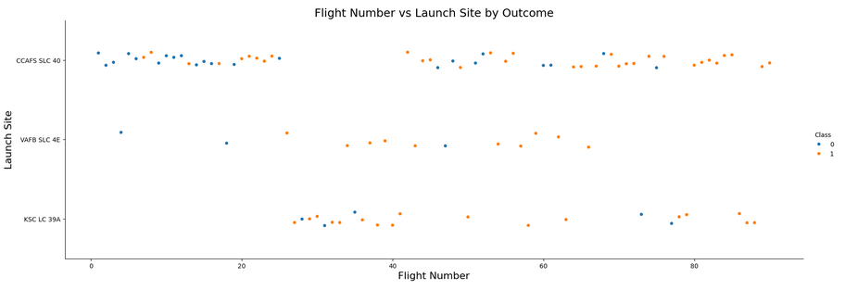
Flight Number vs. Launch Site
Varied Landing Outcomes at Key Launch Sites:
Both CCAFS SLC 40 and KSC LC 39A exhibit a combination of successful (orange) and unsuccessful (blue) landings. This suggests that landing success is likely influenced by factors beyond just the launch site itself.
Steady Launch Activity Across Flight Numbers:
Launches are distributed across a broad range of flight numbers at all locations, indicating consistent operational activity over time without a clear upward or downward trend in landing success.

Slide 19
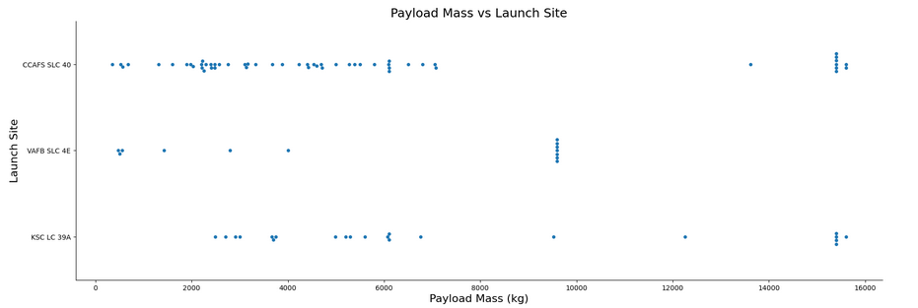
Payload vs. Launch Site
Payload Capacity by Launch Site:
The majority of launches from CCAFS SLC 40 involve payloads under 10,000 kg. In contrast, VAFB SLC 4E and KSC LC 39A support a broader spectrum of payload masses, reflecting a more diverse range of mission objectives.
Frequent Heavy-Lift Missions at KSC LC 39A and CCAFS SLC 40:
KSC LC 39A and CCAFS SLC 40 are regularly utilized for missions involving payloads exceeding 15,000 kg, highlighting its role as a preferred site for high-capacity launches.

Slide 20
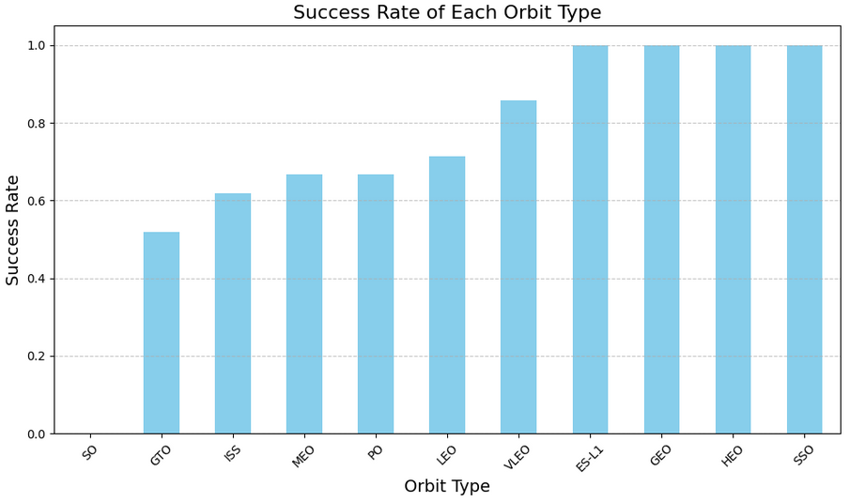
Success Rate vs. Orbit Type
Strong Performance Across Select Orbits:
Missions targeting VLEO, ES-L1, GEO, HEO, and SSO orbits have demonstrated a 100% success rate in first-stage landings, suggesting these trajectories are highly favorable for recovery operations.
Challenges with GTO Missions:
In contrast, missions to GTO exhibit a noticeably lower success rate, indicating that this orbit may present additional technical challenges or operational complexities.

Slide 21
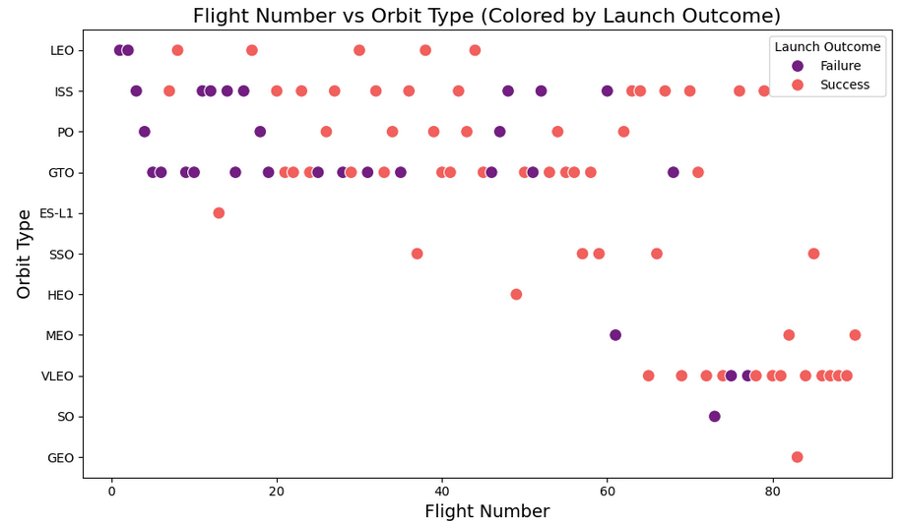
Flight Number vs. Orbit Type
Improved Reliability with Experience :
Falcon 9’s launch success rate shows a marked improvement with increasing flight numbers, highlighting the impact of operational experience and continuous refinement on mission outcomes.
Enhanced Orbit-Specific Success:
While initial missions to GTO and ISS orbits had varied results, more recent launches to these destinations demonstrate significantly higher success rates, reflecting progress in mission design and execution strategies.

Slide 22
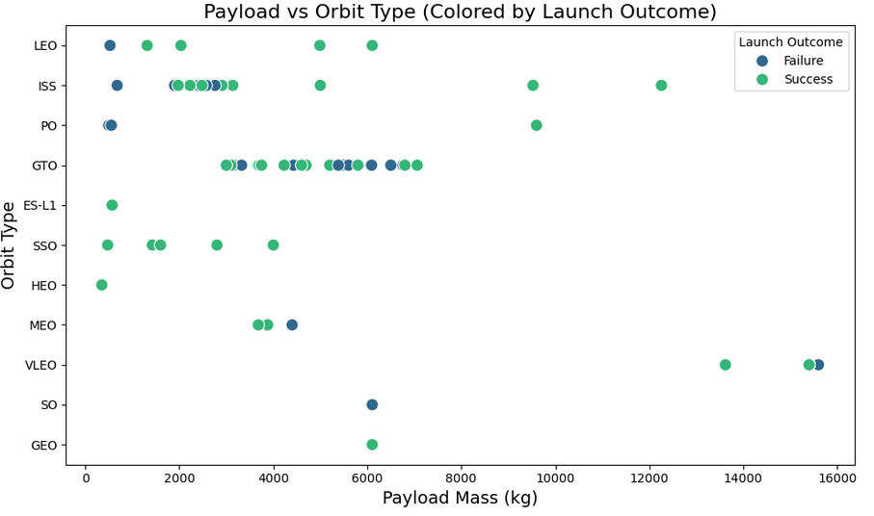
Payload vs. Orbit Type
Higher Landing Success with Lighter Payloads:
Across all orbit types, missions carrying payloads under 6,000 kg tend to achieve successful landings more consistently.
Increased Complexity with Heavier Payloads:
Launches involving payloads over 10,000 kg are rarer and show a mix of outcomes, suggesting that greater payload mass may introduce additional challenges.

Slide 23
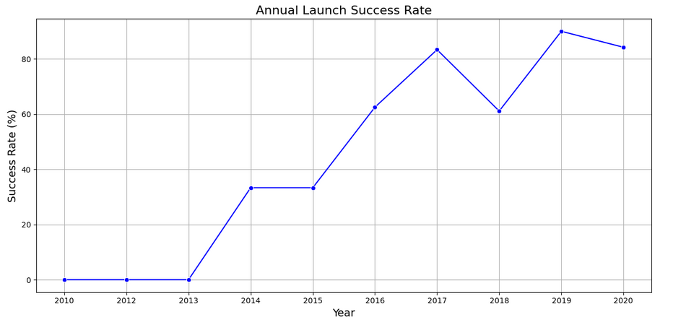
Launch Success Yearly Trend
Steady Improvement in Annual Success Rates:
Since 2013, Falcon 9 launches have shown a notable upward trend in success rates, surpassing 80% by 2020.
Resilience Despite Setbacks:
Although there was a temporary decline in 2018, the overall trajectory reflects growing reliability and consistent performance improvements over time.

Slide 24
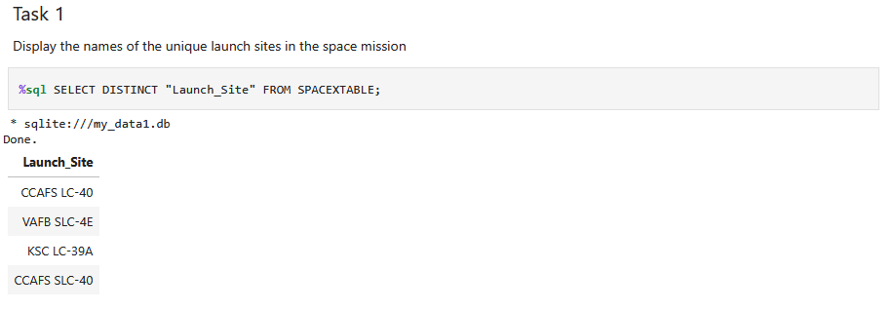
All Launch Site Names
Explaination:
SELECT DISTINCT: Ensures that only unique values are returned, eliminating duplicates.
"Launch_Site": Specifies the column from which to retrieve the data.
FROM SPACEXTABLE: Indicates the table containing the data.

Slide 25
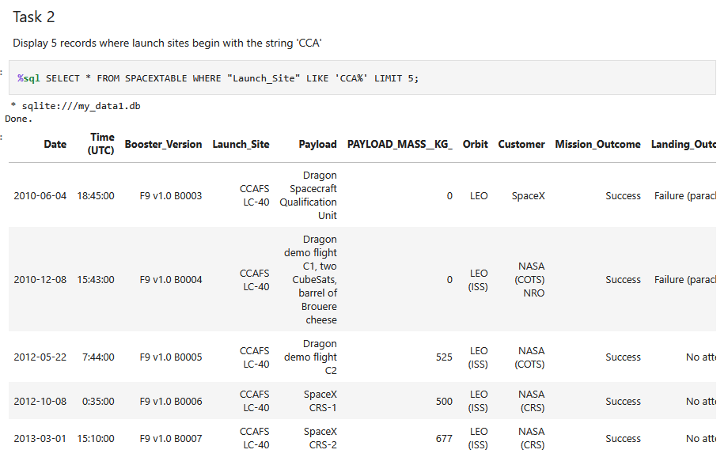
Launch Site Names Begin with 'CCA'
Explaination:
SELECT *: Selects all columns from the table.
FROM SPACEXTABLE: Specifies the table containing the data.
WHERE "Launch_Site" LIKE 'CCA%': Filters rows where the Launch_Site column begins with 'CCA'.
LIMIT 5: Restricts the output to the first 5 matching records.

Slide 26
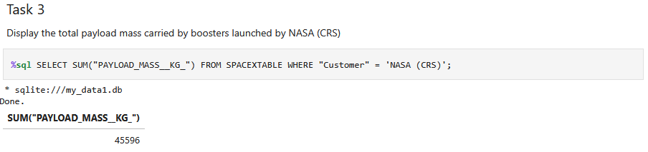
Total Payload Mass
Explaination:
SELECT SUM(...): Computes the total (sum) of the values in the specified column.
"PAYLOAD_MASS__KG_": The column representing the payload mass in kilograms.
FROM SPACEXTABLE: Specifies the table containing the mission data.
WHERE "Customer" = 'NASA (CRS)': Filters the records to include only those where NASA (CRS) is listed as the customer.

Slide 27
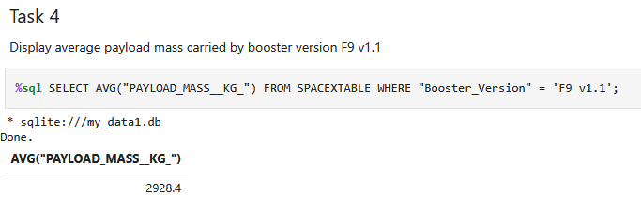
Average Payload Mass by F9 v1.1
Explaination:
SELECT AVG(...): Computes the average value of the specified column.
"PAYLOAD_MASS__KG_": Refers to the column containing payload mass in kilograms.
FROM SPACEXTABLE: Specifies the table containing the data.
WHERE "Booster_Version" = 'F9 v1.1': Filters the records to include only those launched with the F9 v1.1 booster.

Slide 28
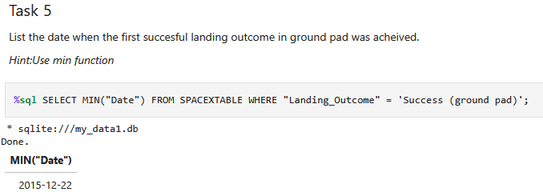
First Successful Ground Landing Date
Explaination:
SELECT MIN("Date"): Retrieves the earliest (minimum) date from the dataset.
FROM SPACEXTABLE: Specifies the table containing the launch data.
WHERE "Landing_Outcome" = 'Success (ground pad)': Filters the records to include only those with a successful landing on a ground pad.

Slide 29
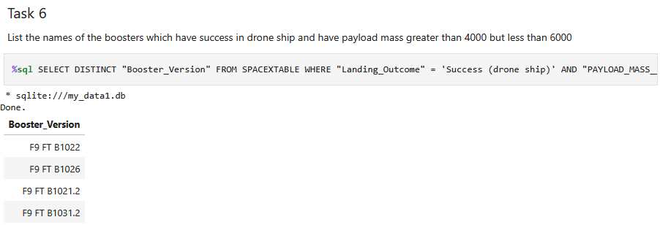
Successful Drone Ship Landing with Payload between 4000 and 6000
Explaination:
SELECT DISTINCT: Ensures each booster version appears only once in the result.
"Booster_Version": The column listing the version of the booster used.
WHERE clause: Filters the data to include only rows where the landing was successful on a drone ship and zhe payload mass was greater than 4000 kg and less than 6000 kg.

Slide 30
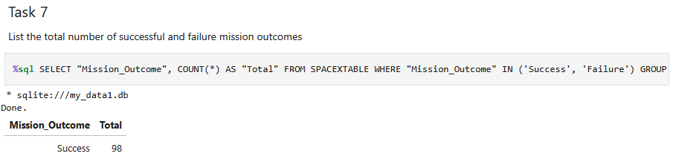
Total Number of Successful and Failure Mission Outcomes
Explaination:
SELECT "Mission_Outcome", COUNT(*) AS "Total": Retrieves each mission outcome (either "Success" or "Failure") and counts how many times each appears.
FROM SPACEXTABLE: Specifies the table containing the mission data.
WHERE "Mission_Outcome" IN ('Success', 'Failure'): Filters the data to include only missions that ended in either success or failure.
GROUP BY "Mission_Outcome": Groups the results by the type of mission outcome.

Slide 31
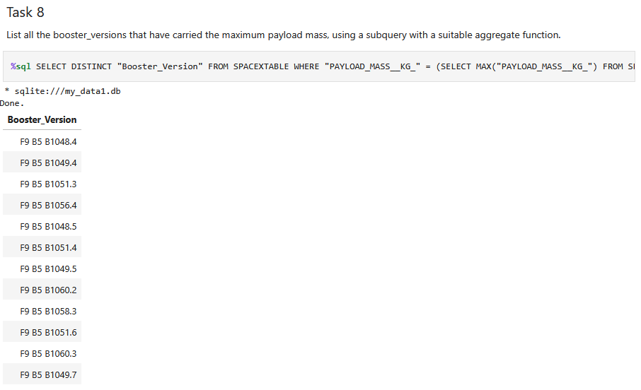
Boosters Carried Maximum Payload
Explaination:
SELECT DISTINCT "Booster_Version": Retrieves unique booster versions.
FROM SPACETABLE: Specifies the table containing the launch data.
WHERE "PAYLOAD_MASS__KG__" = (...): Filters the rows to include only those where the payload mass equals the maximum payload mass in the table.
Subquery SELECT MAX(…) used to find highest payload mass value

Slide 32
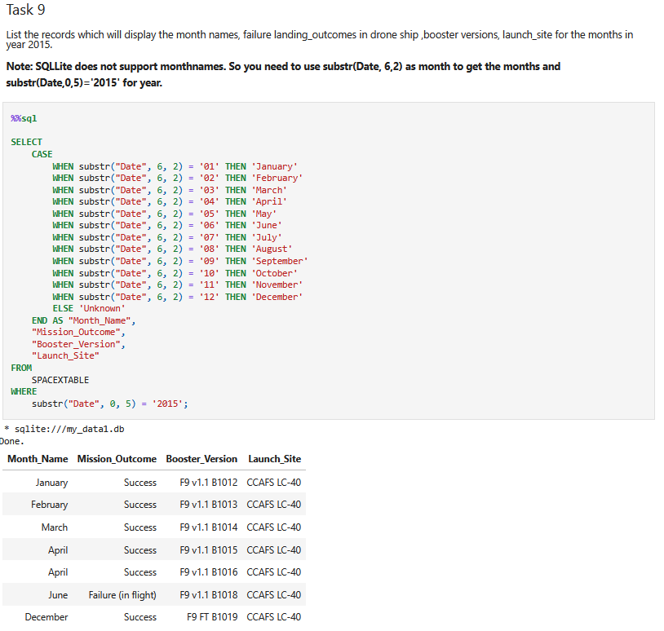
2015 Launch Records
Explaination:
CASE statement: Converts the numeric month (from the Date column) into a readable month name.
substr("Date", 6, 2): Extracts the month part from the date string.
substr("Date", 0, 5) = '2015': Filters records to only include those from the year 2015..

Slide 33
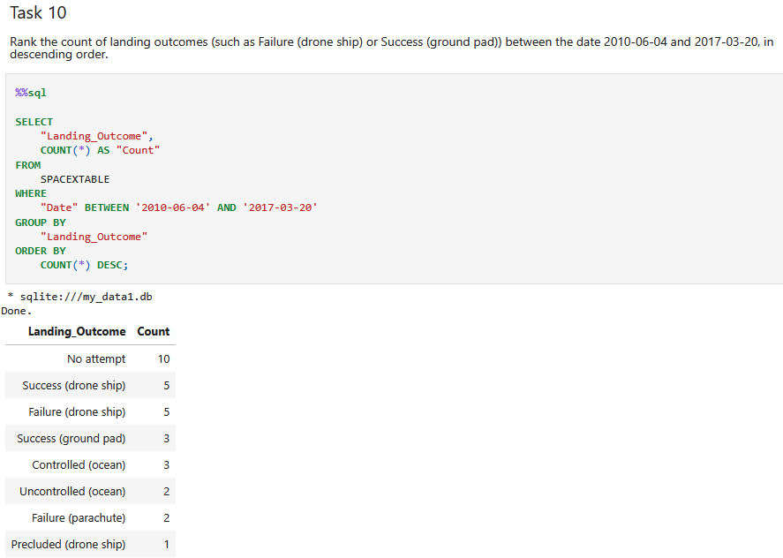
Rank Landing Outcomes Between 2010-06-04 and 2017-03-20
Explaination:
SELECT "Landing_Outcome", COUNT(*): Retrieves each unique landing outcome and counts how many times it occurred.
FROM SPACEXTABLE: Specifies the table containing the launch data.
WHERE "Date" BETWEEN '2010-06-04' AND '2017-03-20': Filters the records to include only those within the specified date range.
GROUP BY "Landing_Outcome": Groups the results by each type of landing outcome.
ORDER BY COUNT(*) DESC: Sorts the results in descending order of frequency.

Slide 34

Section 3

Slide 35
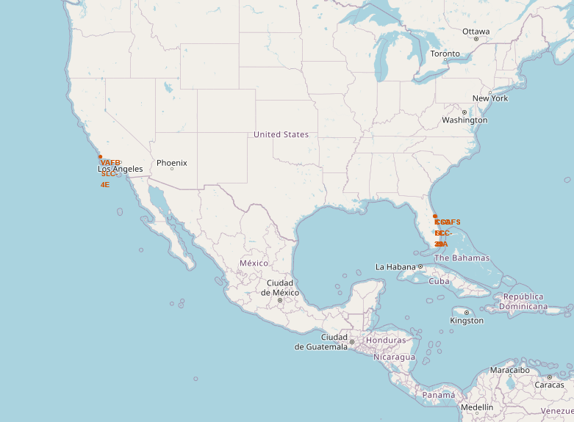
Mark all launch sites on a map
Proximity to the Equator
Not all launch sites are located near the Equator.
For example, Vandenberg Air Force Base (VAFB SLC-4E) is situated at a latitude of approximately 34.63°, which is significantly farther from the Equator compared to the Florida-based sites.
Proximity to the Coast
All launch sites are located close to coastal areas.
The Cape Canaveral sites (CCAFS LC-40 and CCAFS SLC-40) and Kennedy Space Center (KSC LC-39A) are positioned along Florida’s Atlantic coast.
Similarly, VAFB SLC-4E is located near the Pacific coast in California.

Slide 36
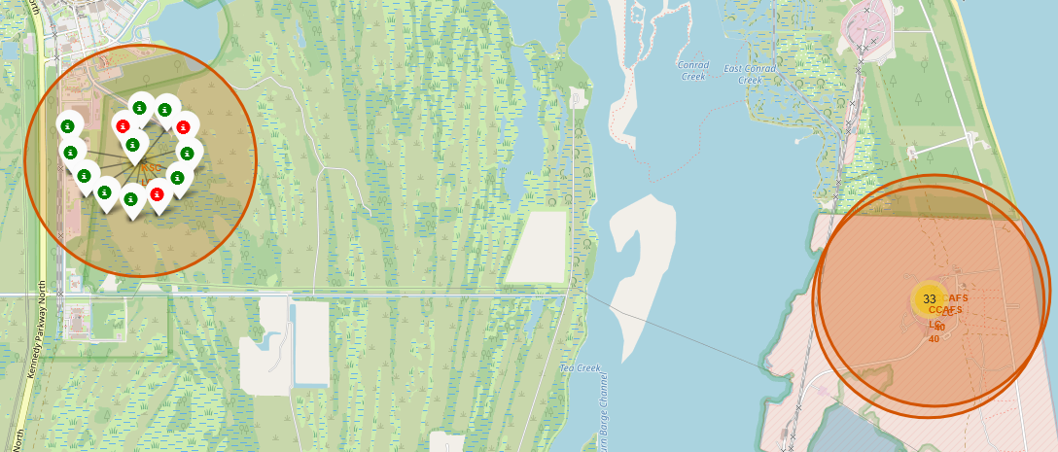
Mark the success/failed launches for each site on the map
This enhanced visualization, featuring clustered markers, significantly improves the exploration and interpretation of SpaceX launch data. By grouping nearby markers, it simplifies the display of dense data points and reveals patterns that might otherwise be obscured in a cluttered map.
The use of color-coded markers and interactive popups provides immediate visual cues and contextual information, enabling deeper insights into launch characteristics and outcomes.

Slide 37
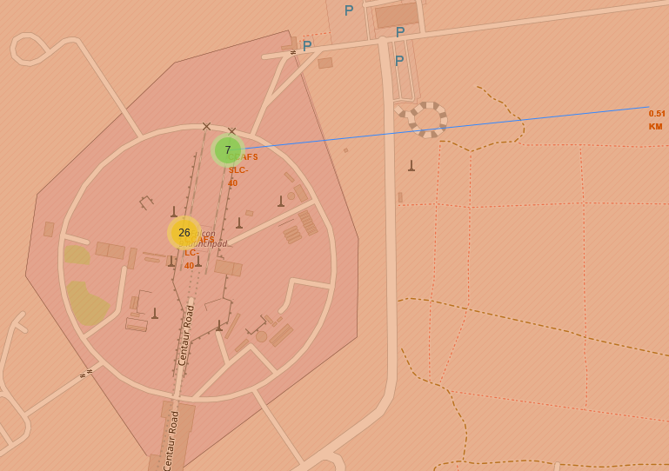
Calculate the distances between a launch site to its proximities
This plot visually illustrates the distance between the CCAFS SLC-40 launch site and the nearest coastline, calculated to be approximately 0.51 kilometers. A straight-line PolyLine has been added to emphasize this proximity, making it easy to interpret spatial relationships.
The site's closeness to the coast is consistent with standard launch site placement, which typically favors coastal locations to enable safe over-water flight paths and recovery operations, thereby minimizing risks to populated areas.

Slide 38

Section 4

Slide 39
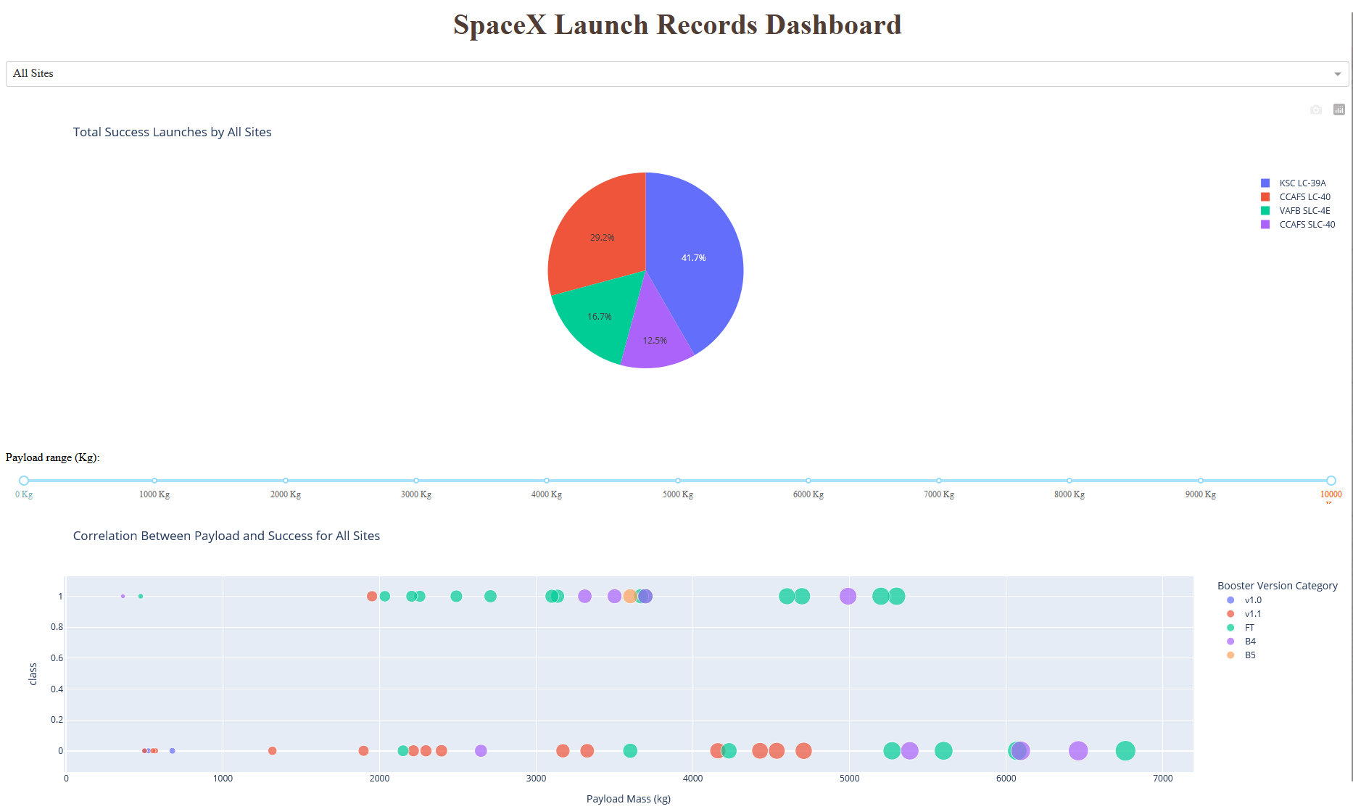
Launch Success Count for all sites
Key Findings
CCAFS LC-40: 29.2%
CCAFS SLC-40: 12.5%
VAFB SLC-4E: 16.7%
KSC LC-39A: 41.7%
KSC LC-39A accounts for the largest share of successful launches, contributing to 41.7% of all recorded successes. This highlights its role as a highly dependable launch site within SpaceX’s operations.

Slide 40
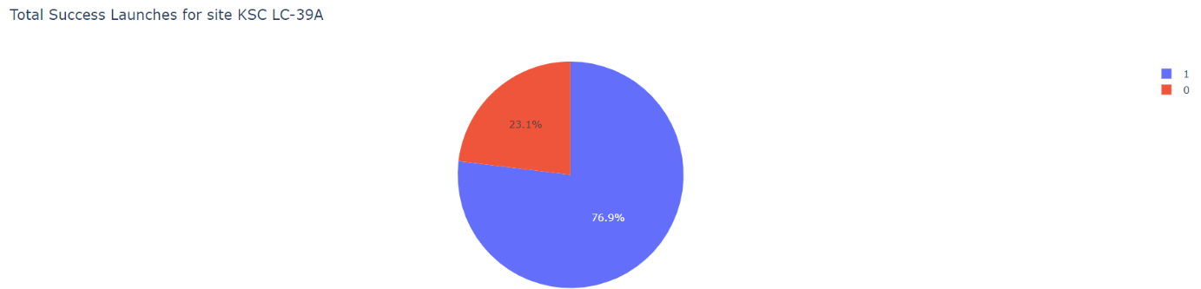
Pie chart for KSC LC-39A
Key Insights
Specifically, 76.9% of launches from this site were classified as Class 1 (successful), while 23.1% were Class 0 (unsuccessful).
This high success rate underscores the operational effectiveness and dependability of KSC LC-39A within SpaceX’s launch infrastructure.

Slide 41
Scatterplot for booster versions and general findings
Booster Version Performance
The “FT” booster version stands out as the most frequently deployed, with a strong success rate across a wide range of payload masses.
The “v1.0” booster version has been used less often and may require further analysis to assess its performance accurately.
Overall, there is no clear correlation between higher payload masses and lower success rates across booster versions.
General Findings
KSC LC-39A has highest success rate
Other can be assumed to have lower performance

Slide 42

Section 5

Slide 43
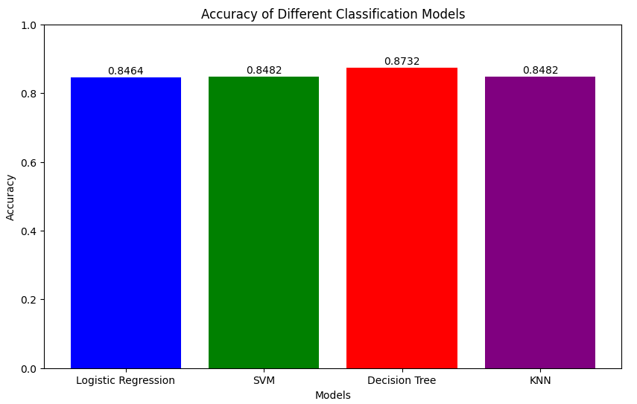
Classification Accuracy
Key Insights
Highest Accuracy was achieved by Decision Tree in the Cross Validation

Slide 44
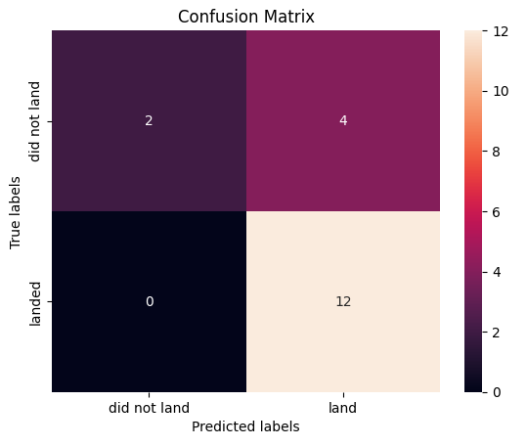
Confusion Matrix
Key Insights
True Positives (TP = 12): The model correctly predicted 12 landings.
True Negatives (TN = 2): The model correctly predicted 2 non-landings.
False Positives (FP = 4): The model incorrectly predicted 4 landings when the rocket did not land.
False Negatives (FN = 0): The model did not miss any actual landings.

Slide 45
Conclusions
Key Conclusions
Launch Site Performance: The analysis identified KSC LC-39A as the top-performing launch site,. This suggests that the site may benefit from favorable conditions or operational efficiencies that contribute to its high success rate.
Booster Version Reliability: The “FT” booster version demonstrated a consistently high success rate across a wide range of payload masses. Its strong performance indicates that it is a robust and reliable choice for future missions aiming to maximize launch success.
Payload Mass vs. Success Rate: No significant correlation was found between payload mass and launch success. This implies that other factors—such as the launch site and booster version—are likely more influential in determining mission outcomes.

Slide 46


